Slide 1


The chosen approach
Activity Guidelines (duration intervals for both the whole activity and it’s (potential) composing parts, available locations and temporal intervals)
User-defined constraints (proximity-based, ordering, duration-based)
User-defined preferences (proximity-based, duration-based, time interval placement-based, implication-based)
Resulting schedule:
Scheduled Activity 1
start time: x1
duration: y1
location: l1
Scheduled Activity 2
start time: x2
duration: y2
location: l3
...

Slide 2

FLEXITIME
A deep dive into the
developement of an
automatic schedule
generator
Gheorghe Octavian

Slide 3

Why choose this?
01.
02.
03.
04.
05.
Manual scheduling is time-consuming
Growing demand for adaptive scheduling
Real-world practicality
Potential for increased user satisfaction
Lack of intelligent support in existing tools

Slide 4

01
02
03
The chosen approach and it’s elements
State of the art
Heuristic vs Machine Learning
Squeaky Wheel Optimization Algorithm
06
05
04
Testing Methodology
Validation
Experimental validation
Estimated utility vs Accumulated Utility
The proposed Architecture of the Application
07
08
Timeline
Live Demo
Future Work

Slide 5
The chosen approach
3, 4
d3
4 << 3
Activity 1
mindur: d1, maxdur: d2
locations: l1, l2
time intervals: [a1, b1], [a2, b2]
Resulting schedule:
Scheduled Activity 1
start time: x1
duration: y1
location: l1
Scheduled Activity 2
start time: x2
duration: y2
location: l3
...
Activity 3
mindur: d5, maxdur: d6
locations: l2, l3
time intervals: [a2, b2], [a4, b4]
2, 4
d5
1, 2
d1
Activity 2
mindur: d3, maxdur: d4
locations: l2
time intervals: [a3, b3]
Activity 4
mindur: d7, maxdur: d8
locations: l1
time intervals: [a1, b1]
1 << 2
2 → 1

Slide 6
Problem Definition
Given a set of user defined activities, constraints and preferences, alongside the locations of the activities, generate a feasible schedule that satisfies all of the hard constraints and aims to align with the user’s soft preferences

Slide 7
State of the art
HEURISTIC-BASED
MACHINE LEARNING-BASED
General approaches
Rule or logic-based methods.
iterative search strategies.
Interpretable.
Pros
Transparent Behavior.
User-Friendly.
Interactive.
General approaches
Data-driven, adaptive systems.
Best at discovering implicit patterns and generalizing.
Pros
Generalization
Autonomous Adaptation
Supports Complex Models

Slide 8
Why choose the heuristic-based approach?
Better User Control and Customization
Supports Interactive Feedback and Iteration
Strong Constraint Handling

Slide 9
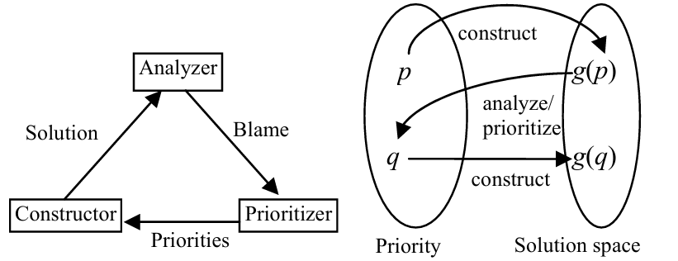
Squeaky-Wheel Optimization
GENERAL STRUCTURE
Construct: Build a complete solution based on current activity priorities
Analyze: Identify which parts of the solution are unsatisfactory or conflict prone.
Prioritize: Reorder the priority queue to address the most problematicele ments earlier in the next construction cycle.

Slide 10



Proposed architecture
DATABASE
BACKEND (USING JAVA)
FRONTEND (USING JS)
Cloud Scalability
Relational Structure for Complex Scheduling Logic
Secure and Managed Connectivity
Robust Business Logic Encapsulation
Efficient API Layer and Security
Maintainability
Responsive, Interactive UI
Modular Component Design
Secure, Authenticated Integration with Backend

Slide 11
Experimental validation
ESTIMATED UTILITY
ACCUMULATED UTILITY
DIFFICULTY OF ACTIVITIES IN PRIORITY QUEUE
DIFFICULTY OF ACTIVITIES IN PRIORITY QUEUE
General strategy: Take each remaining activity and based on it’s current temporal domains find an ideal placement of it such that the utility is maximized. Do that for every utility source (preference, constraint). Take the sum of it all and divide it by the difficulty to place the activities.
ISSUE: no real algorithmic implementation, only emulating the perfect schedule through general guidelines and trial and error
General strategy: For each of the already scheduled activity, alongside the partial solution we are currently on, calculate the utility using all of the existing sources (preference, constraint), take that sum and divide it by the difficulty to schedule the remaining activities in the priority queue.
IMPORTANT: We only do this for schedules that do not produce a difficulty metric over 1 for any activity remaining

Slide 12
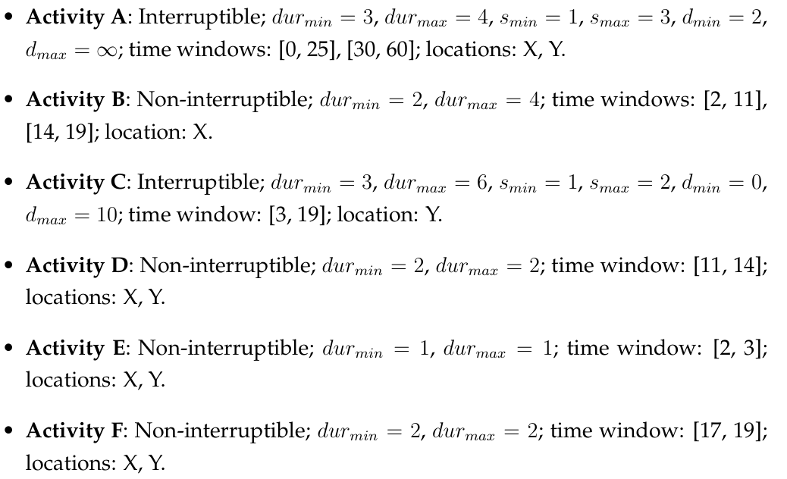
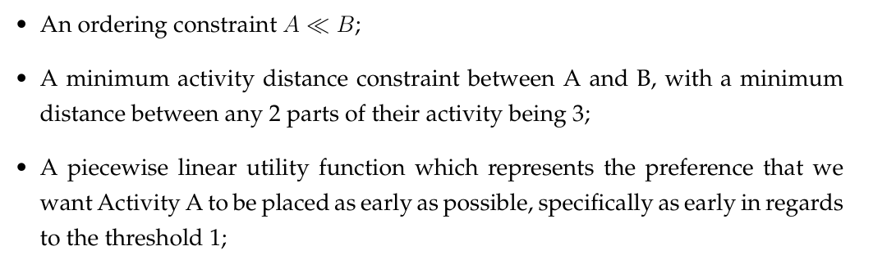
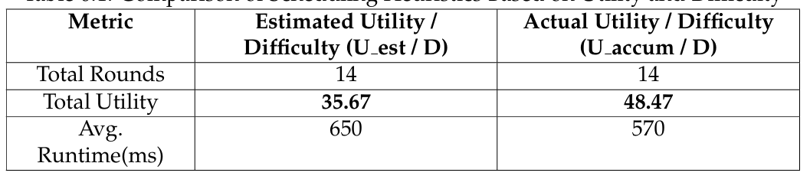
Experimental validation: Results for the first set

Slide 13
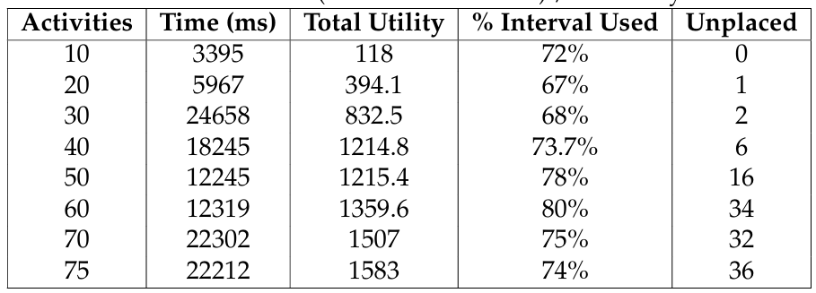
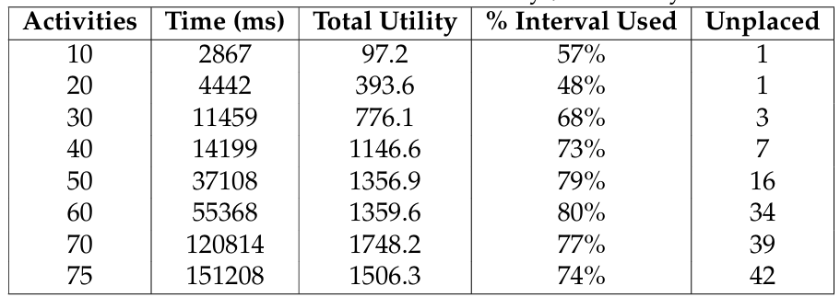
Experimental validation: Results for the second set
Accumulated utility
Difficulty
Estimated utility
Difficulty

Slide 14
Testing
APPLICATION FLOW TESTING
SERVICE LAYER TESTING
HEURISTIC LOGIC VERIFICATION
Manual end-to-end testing through the frontend to validate user workflows (e.g., registration, activity creation, schedule generation) and confirm integration between frontend, backend, and database
Unit testing of backend service methods using mocked repositories (with Mockito) to verify correct CRUD operations, relationship enforcement, and exception handling for entities like users, activities, and constraints
Custom test scenarios designed to evaluate the correctness and feasibility of the SWO algorithm's output under various constraint-heavy and utility-sensitive configurations

Slide 15
LIVE DEMO

Slide 16
Future improvement
Algorithm-Wise
OPTIMIZED TASK PRIORITIZATION STRATEGY
ESTIMATED UTILITY MODELING
This would allow smarter comparisons between multiple schedules
A more scalable technique that better adapts to evolving task complexity across multiple scheduling runs
Application-Wise
MANUAL SCHEDULE EDITING
3RD PARTY INTEGRATION
Enable users to export schedules directly to Google Calendar and define real-world activity locations using Google Maps
Allow users to fine-tune their generated schedules manually

Slide 17
THANK YOU!

